Slide 1
DE2370 Video Production
K.Linganasean
120337H

Slide 2
Motion

Slide 3
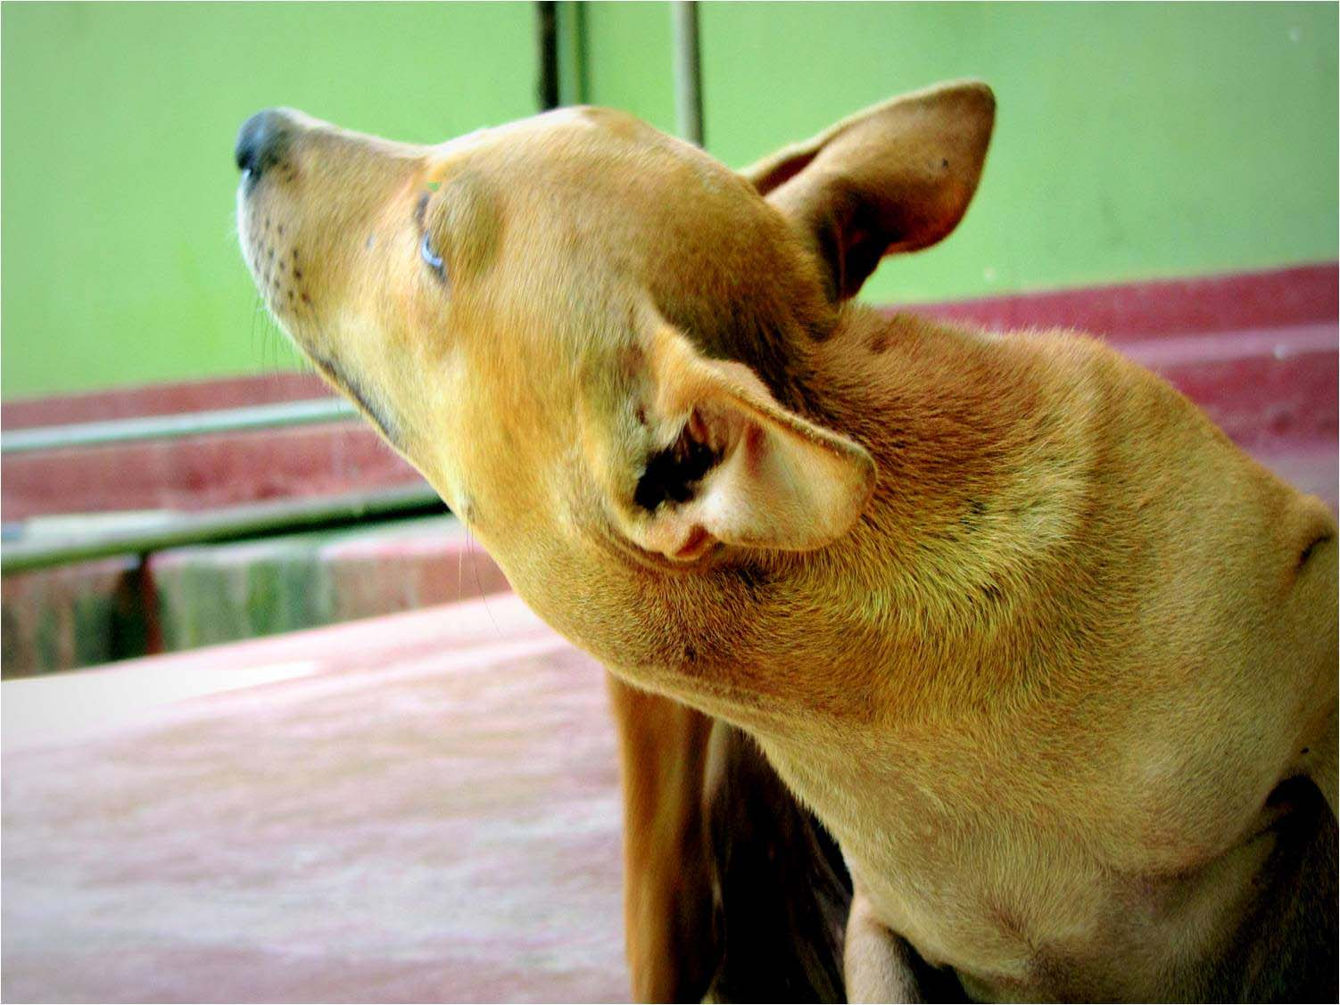

Slide 4
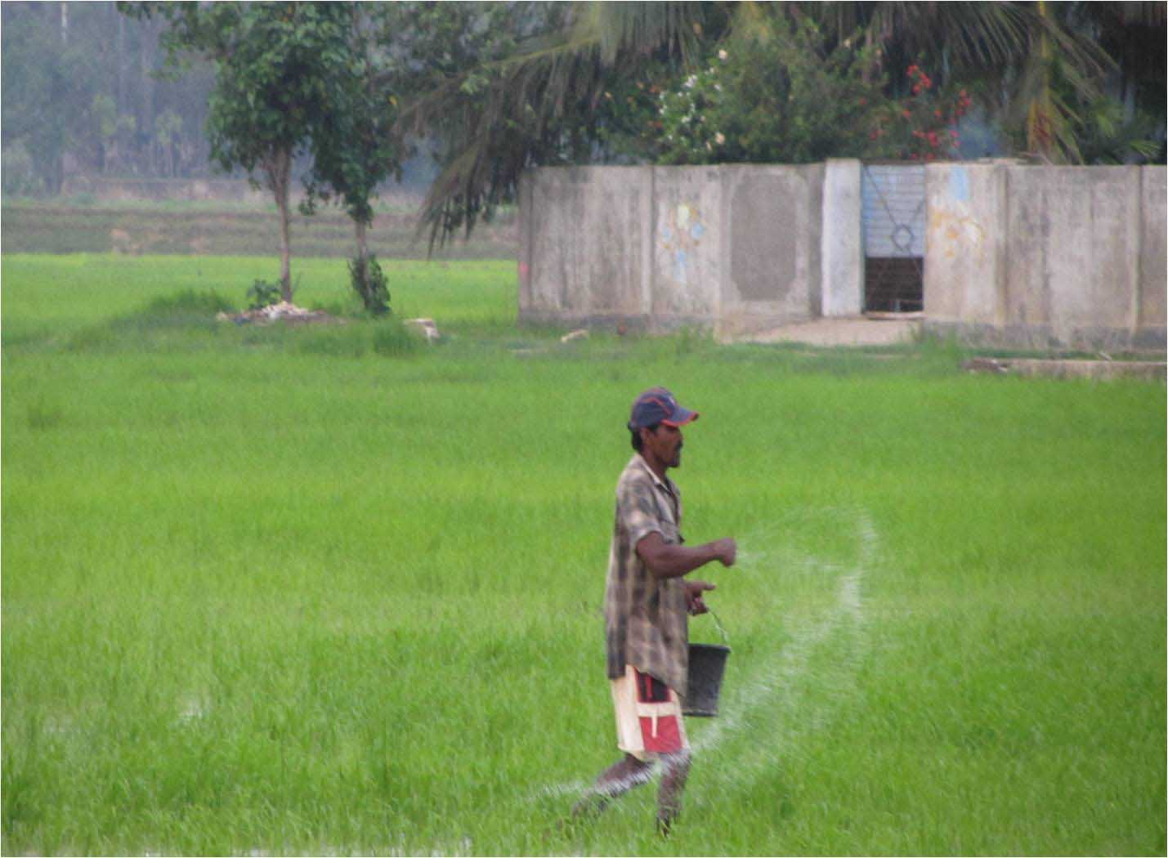

Slide 5
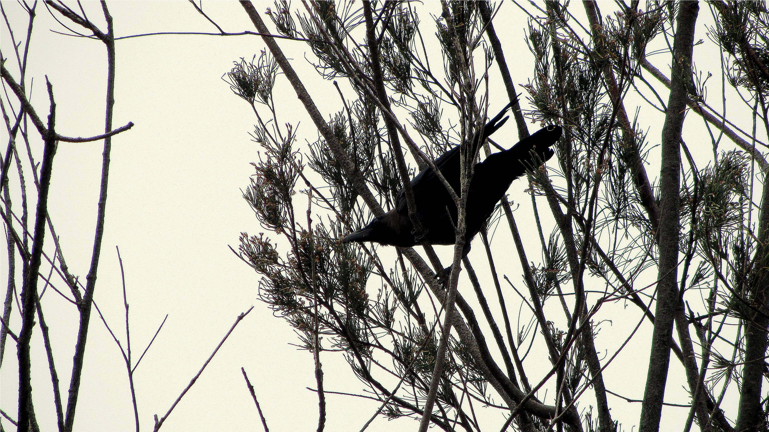

Slide 6


Slide 7
Texture

Slide 8
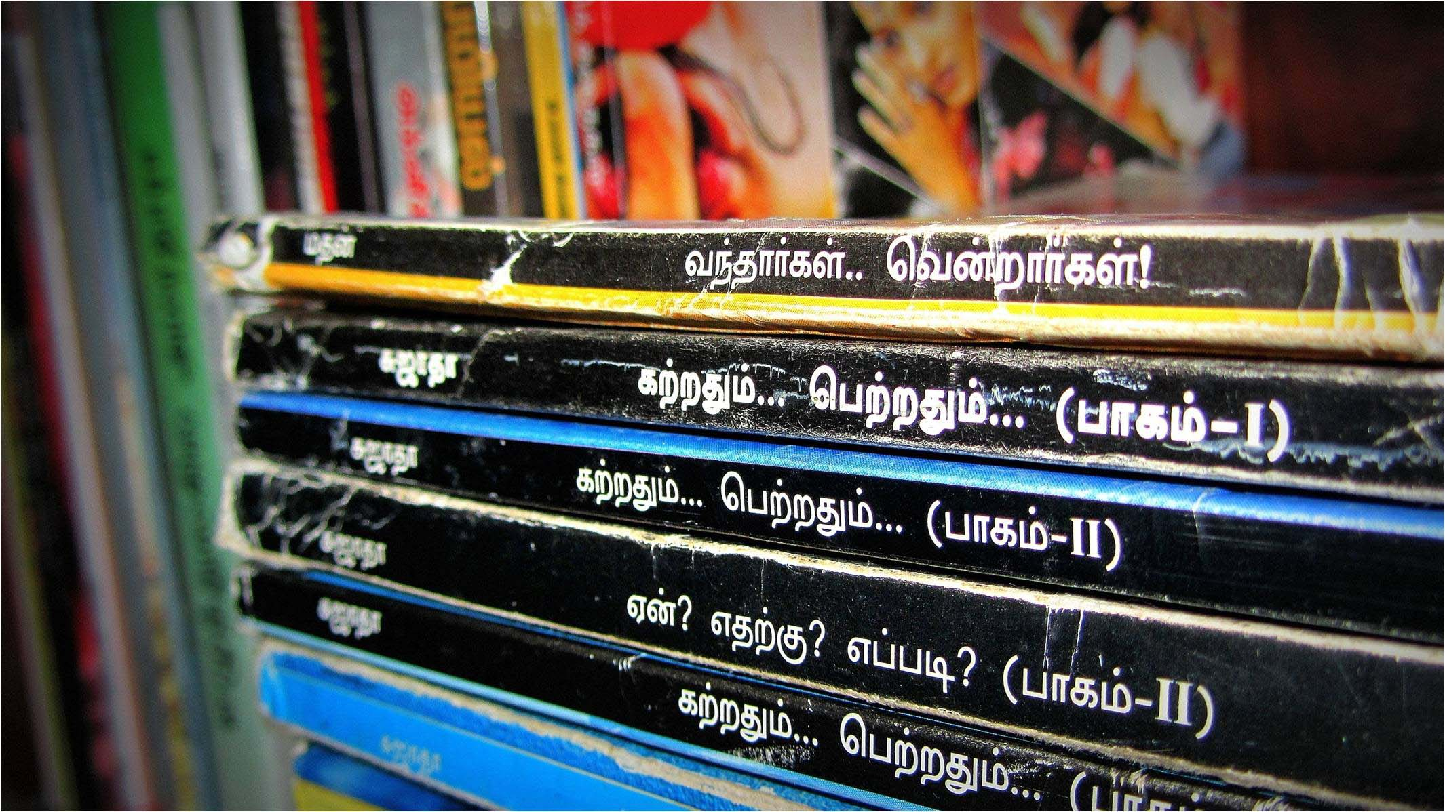

Slide 9


Slide 10
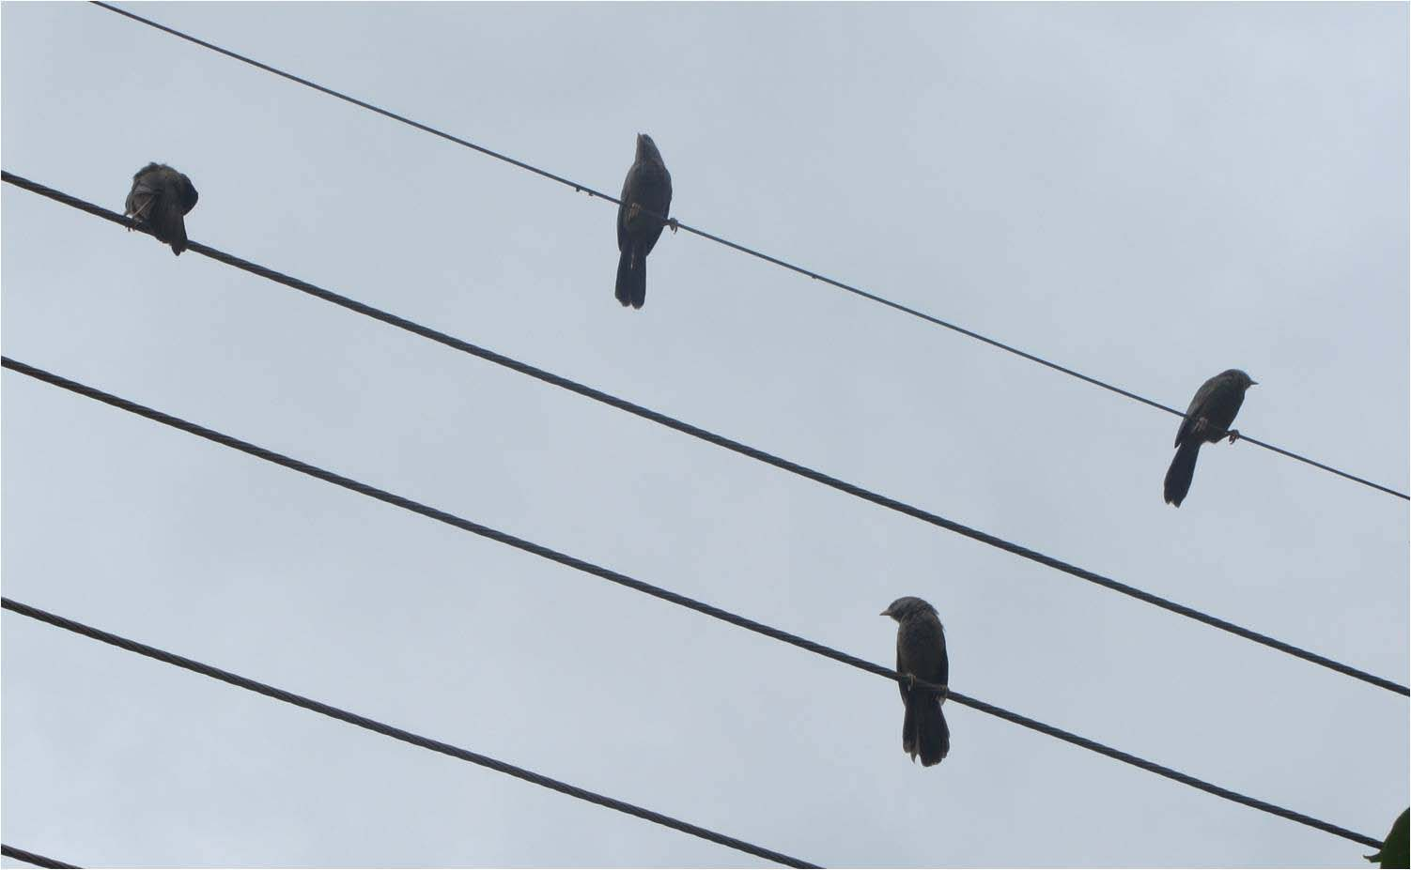

Slide 11
Portrait

Slide 12
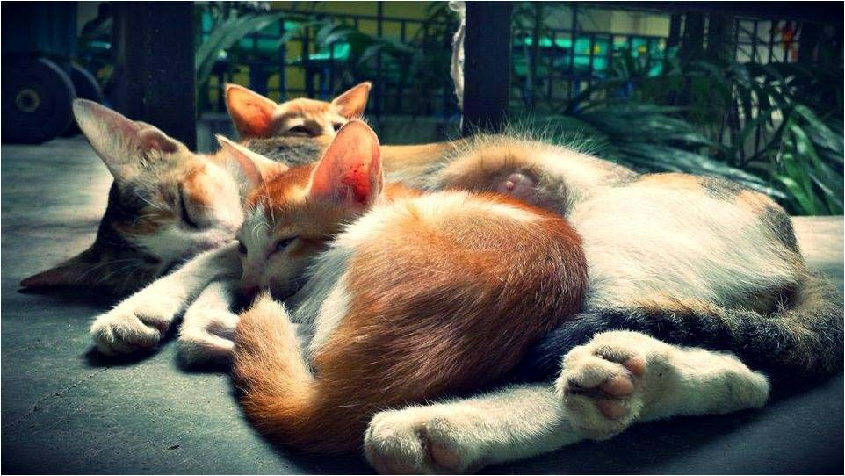

Slide 13
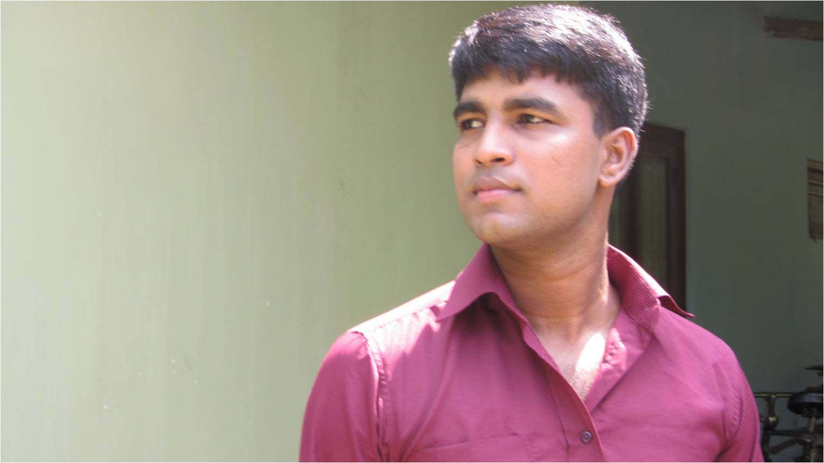

Slide 14
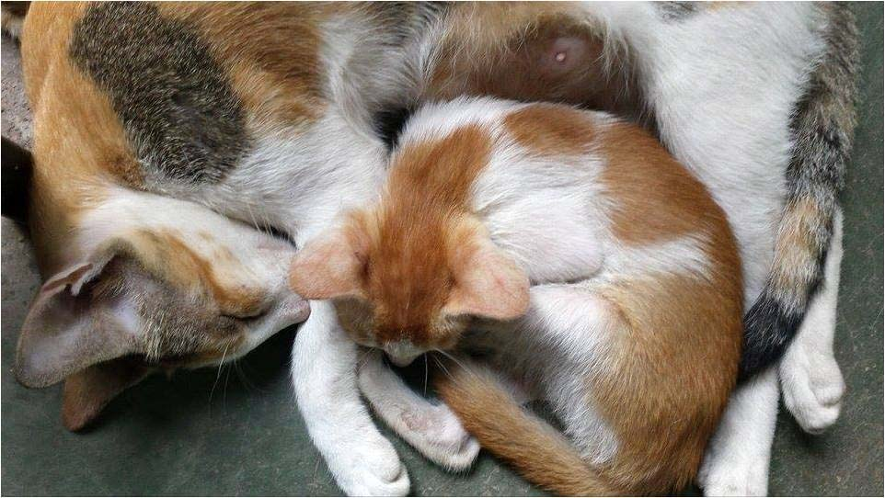

Slide 15
